Slide 1


San Diego Blood Bank
Submitted By- Shivi Sahai

Slide 2
Objective
San Diego Blood Bank (SDBB) is a browser-based system that is designed to store, process, retrieve and analyze information concerned with the administrative and inventory management within a blood bank.
This project aims at maintaining all the information pertaining to blood donors, blood recipients, different blood groups available in each blood bank of San Diego on the basis of zip code and help them manage in a better way.
Aim is to provide transparency in this field, make the process of obtaining blood from a blood bank hassle free and corruption free and make the system of blood bank management effective and user friendly.

Slide 3
Project Scope & Features
San Diego Blood Bank Home page.
Blood Donor Management page.
Blood Recipient Management page.
San Diego Blood Banks Center Information & Data

Slide 4
Brief Overview of Technology
Front end: HTML, CSS, javascript, AJAX
Backend: PHP, MySQL
Software Requirement: Netbeans IDE 12.0, XAMPP Server

Slide 5
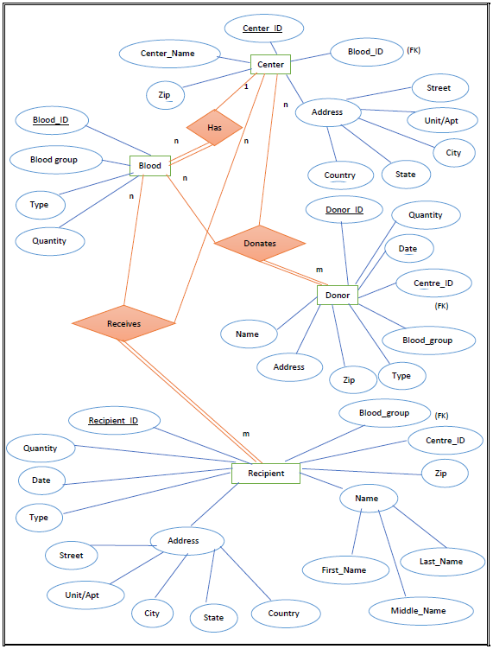
Database ER Representation

Slide 6

Thank You!

